Slide 1
Lab3
Working towards Milestone 1

Slide 2
Today's Lab
In today's lab you'll build on Lab 2 to identify specific themes, motivations, tasks and interview questions to ask your users.
These Labs 1, 2 and 3 are designed to help you with the first project Milestone

Slide 3
Important Milestone1 Dates
In our next lab (LAB 4 – Oct. 12) – you will work the Appendices for Milestone1. These will be due Thursday Oct. 13 at 11:00pm (then we can give you feedback specifically on these) ​
In the Lab on Wednesday Oct.19 you will pilot your study (everyone needs to be at the lab). Then you will have time to make last minute changes to your study tools. ​
The full Milestone1 is due Thursday Oct. 20th at 11:00pm​
You will run the study in Lab on Wed. 26 (again everyone needs to be present).​
Info on the pilot and how to run the study will be discussed in the lab on Oct. 12 and class Oct. 17.​

Slide 4
Lab 3 Instructions
Scenarios, tasks and questions that you could ask users to do on the application:
Tweak the relevant tasks that you did in Lab 2 based on the feedback and to create short scenarios.
For this lab, ensure the wording is specific enough that a user knows what to do when using/trying the app (just saying "find a fast bus route" or "order food", for example, would be too vague) without telling them specific steps (e.g., click the button that says "[something]", then click the link that says "[something"]…).
For Example, if the topic was using a bus transit app on a Smartphone and the identified theme was to find the fastest route to a particular location:
Task Theme: Find the fastest bus route from point A to point B.
Then you need to come up with a short, precise scenario to help motivate your user to do the task
[Motivation scenario]:
"Imagine, you work at the Superstore on Quinpool Street in Halifax and are late for work. You need to fastest bus route to work."
Specific Task wording: Then you include the motivation scenario with a very specific task (specific in terms of what to do, not how to do it)
"Imagine, you work at the Superstore on Quinpool Street in Halifax and are late for work. You need to fastest bus route to work. Using Google Maps find and tell us the fastest bus route from the corner of Spring Garden Road and Barrington Street going to Atlantic Superstore on Quinpool Street, leaving after 1:00pm."
Note, in the above task you have given enough information for the user to know what to do but you have avoided telling them how to do it (e.g., do not say "click the clock icon to bring up the schedule, then click on the two locations on the map, etc.." as this tells the user how to do task. The point of asking them to do a task, is to observe how they would naturally do the task to discover any problems or even potential short cuts.

Slide 5
Lab 3 Instructions
Once you have come up with the exact wording for the task, you need to come up with 4-5 questions that you could ask your participants after doing the task. For example, based on the previous example:
Sample Interview Questions after performing the task:
Q1: What features in the app did you use to help you find the fastest route?
Q2: What did you like and/or dislike about using these features?
Q3. Have you done this task (or a similar task) before in real life? [if yes - Describe any problems or issues you've had when doing this?]
Q4. What suggestions do you have to improve the features you used to complete the task (suggestions for additional features)?
Q5. How do you currently find bus routes (e.g., what apps do you use, websites, other means and how do you use them)?

Slide 6
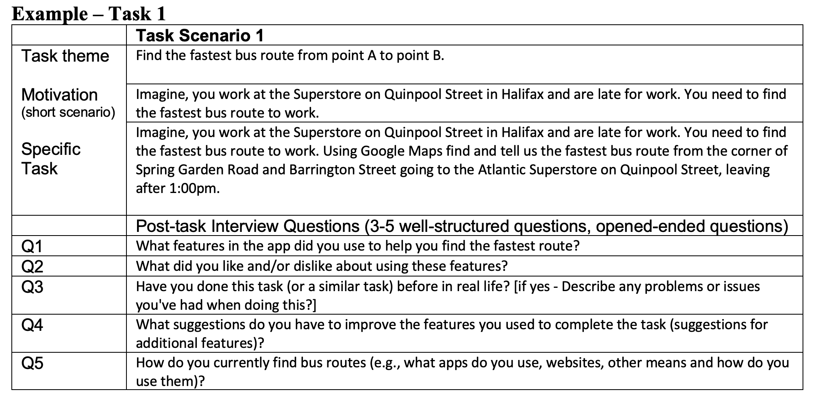
Lab 3 Instructions – Part 1
You will come up with 4 tasks and use this template to complete the specific task wording and post-task questions (4-5 questions per task)

Slide 7
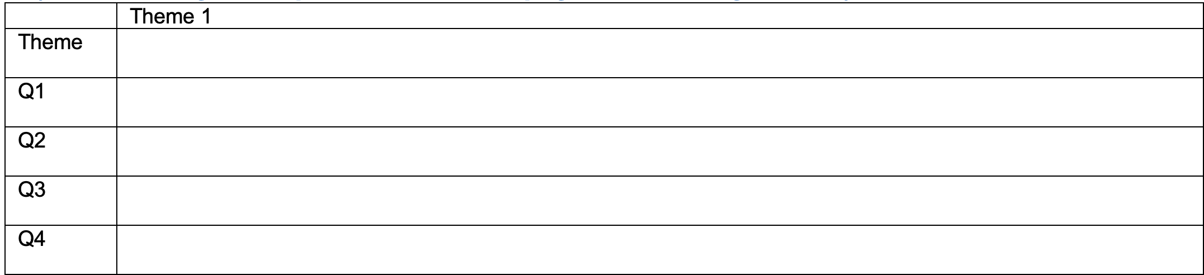
Lab 3 Instructions – Part 2
Post Study Interview Questions
After your participants have completed your tasks/questions, come up with general questions related to using the app you've chosen and/or doing the action the app was designed to help (even if they don't use the exact app), etc.
Come up with 3-4 specific themes that you are interested in learning more about related to your topic, (e.g., Theme 1: getting directions, …Theme 4: avoiding traffic hold ups)
For each theme, come up with 3-4 good questions (maximum 5). These should be open-ended questions (avoid yes/no questions or at least after a yes/no inquire "why").
Remember this is a semi-structured interview so you may want to include some prompts for questions to help the participants answer.
These questions should NOT be related to your ideas for design but rather to their current experience using the application (or similar ones) and/or their thoughts on improvements.

